Slide 2
Notes:
Hello, my name is _____, I am ____ years old and I have been a Climate Justice Ambassadors of Plant-for-the-Planet for ___years.
I give presentations, to fight for our future.

Slide 3
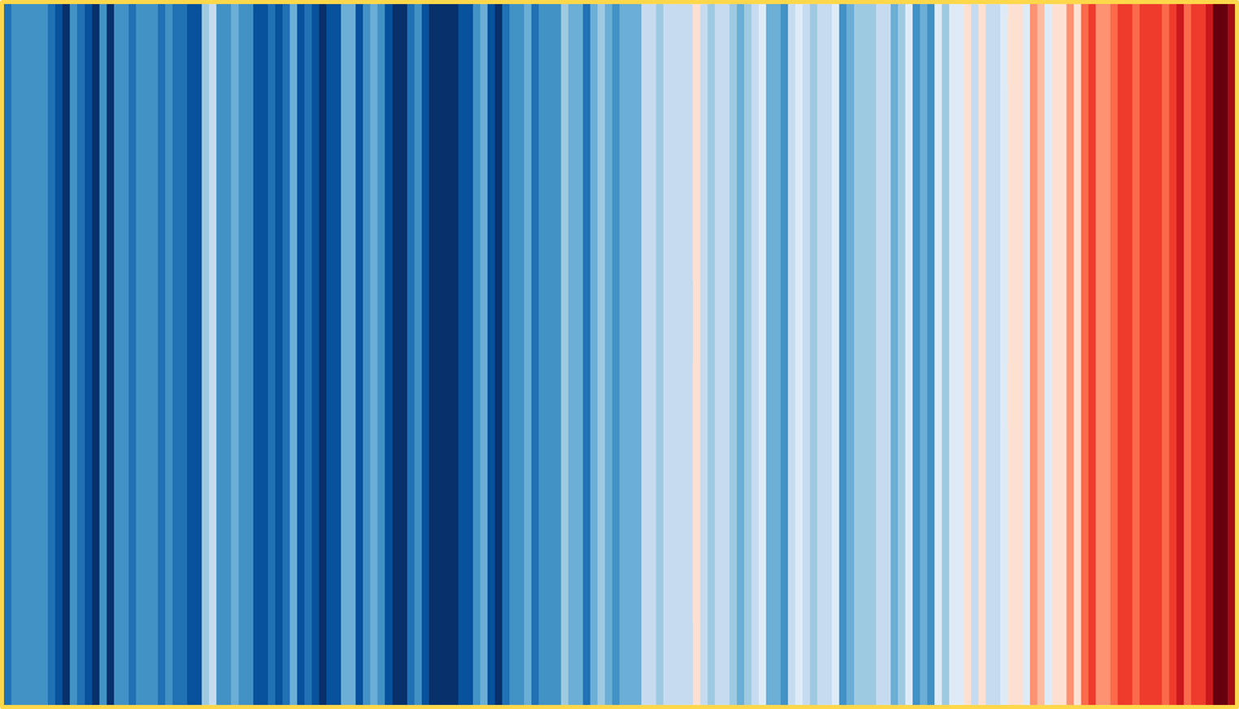
Notes:
To start with, what do you think this image shows? (wait for an answer from the audience)

Slide 4
yearly global temperature from 1850-2017
Notes:
These are great colors and it may look nice, but for us children and teenagers it is a huge catastrophe. (if necessary adapt to answers from the audience)
On the picture you can see the global average temperature from 1850 to 2017. Blue stands for rather cold temperatures, pink, red up to brown for very warm temperatures.
So you can clearly see that with the beginning of industrialization, so from the time when people started to work with machines and engines, temperatures have been rising more and more and we humans have a big influence on this.
You hear and read this more and more often in the news: it is getting warmer and warmer. That sounds quite nice at first when we think of our summer vacations, but is it really? And what does the rise in temperature actually mean for people all over the world?

Slide 5
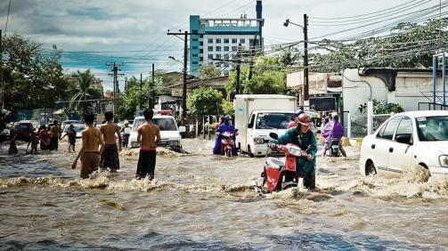
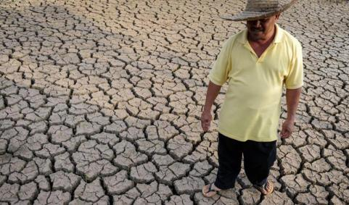
Consequences of the climate crisis
© pixabay, cienciamx
Notes:
This rise in global temperatures has catastrophic consequences, as you can see here.
The left picture was taken in Bangladesch. In many areas of the world the floods are getting worse.
In other areas droughts are getting worse, as can be seen in the picture on the right, taken in China.

Slide 6
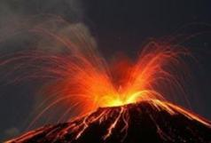
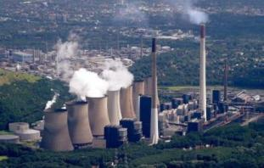

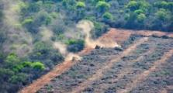
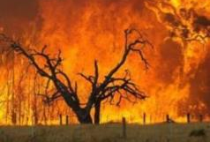
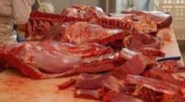
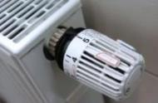
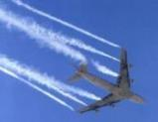
Sources of Carbon dioxide (CO₂)
Natural sources
Human-made sources
Notes:
But why is it getting warmer?
Various gases in the atmosphere are to blame, especially carbon dioxide, or CO₂ for short. It is invisible and everywhere. We cannot smell it, taste it, see it, but it is everywhere in our air.
There are two main sources:
It comes naturally from volcanic eruptions, forest fires and rot, like compost decay. These things have always existed, but the earth has always been able to store as much CO₂ as it has produced. So there has always been a balance.
The second cause is us humans. In always everything we do, we produce CO₂: by producing the things we buy, by driving a car, heating our home, using electrical appliances or by flying aound the world for holidays.
We humans produce more CO2 every year. The world is no longer able to store everything. So there is no balance anymore.
That's why we also talk about the human-made climate crisis.

Slide 7
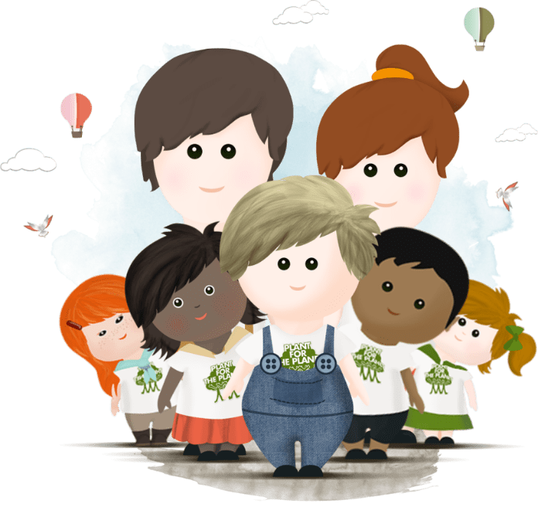
Why do we talk about...
Climate crisis
Notes:
I will be using the word climate crisis in my lecture. You may wonder why I am talking about a crisis instead of climate change as others do.
We, Climate Justice Ambassadors, speak of climate crisis, because we are in a dangerous situation. We must act NOW, otherwise, as you heard earlier, we will not be able to reverse the rise in temperature and its consequences. We think the word climate change sounds much too positive and does not describe how important and urgent the situation is. For us it is a crisis that threatens our lives.

Slide 8



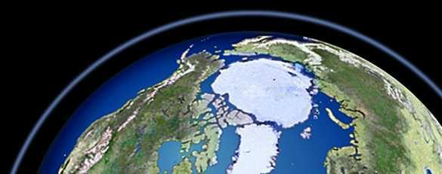
The Greenhouse Effect
Notes:
Before we go any further into the climate crisis, I would like to explain to you briefly what actually happens to the CO₂ in the earth's atmosphere.
Many of you have probably heard about the greenhouse effect.
In the picture here you can see the earth without an atmosphere. The atmosphere is a transparent gas shell surrounding the planet. It is the basis for all life on earth.
If we had no atmosphere, all the sun's rays that come down on the earth would immediately radiate back into space. Then it would be much too cold on earth for us to live.

Slide 9
The Greenhouse Effect
Notes:
But fortunately we have the atmosphere. The sun's rays come to earth through the atmosphere.
The sun's rays, which arrive on the earth, warm the earth's surface and are reflected back from the earth's surface as heat rays and return to space. But not all of them.
A few heat rays get caught in the atmosphere. That is also good in such a way, otherwise it would be too cold in the world for us humans.

Slide 10
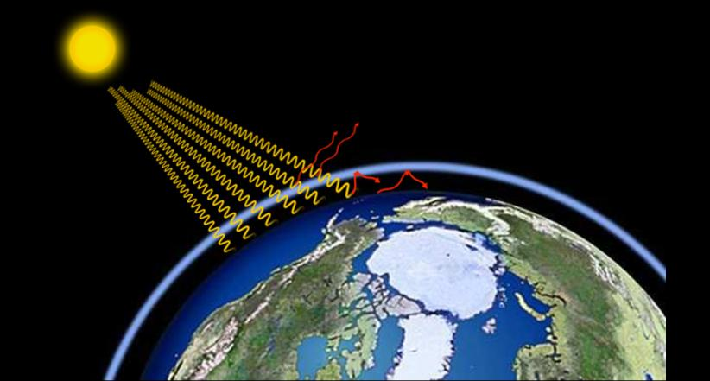
The Greenhouse Effect
Notes:
However, the greenhouse gases, especially CO₂, are causing the atmosphere to become thicker and thicker. The thicker the atmosphere is, the less heat rays can escape back into space, and thus the temperature rises.
If it is too warm on earth, it becomes unbalanced. This is what we call the climate crisis.

Slide 11
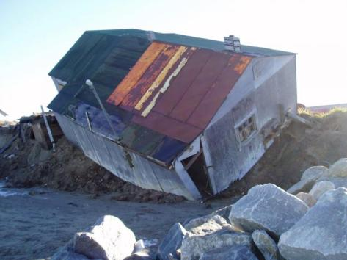
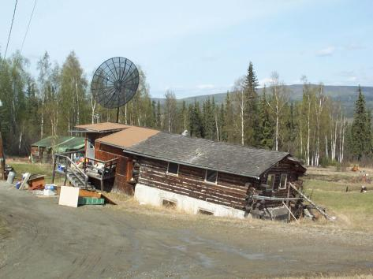
Tipping points
© 2020 Vice Media Group, Vladimir Romanovsky
Notes:
To counteract this, politicians have set the plus two degrees Celsius limit. Perhaps you have heard of it before. This means that they are trying to limit the temperature rise to plus 2°C by 2050.
We have an even bigger problem than the weather extremes that are already occurring.
When the temperature rise exceeds a certain value, sudden changes occur on earth that are irreversible. These are called tipping points. Tipping points are therefore like a time machine into the future. They accelerate the climate crisis and, once triggered, can no longer be reversed.
One example is the thawing of the permafrost soils in Siberia and Alaska. Permafrost means that the ground is always frozen, even in summer. A lot of CO₂ is stored in it. When it melts because of higher temperatures, this CO₂ is released. So there is even more CO₂ in the atmosphere, which again leads to higher temperatures, which in turn accelerate the thawing of the permafrost soil. The cycle continues and makes the climate crisis even more dangerous.

Slide 12
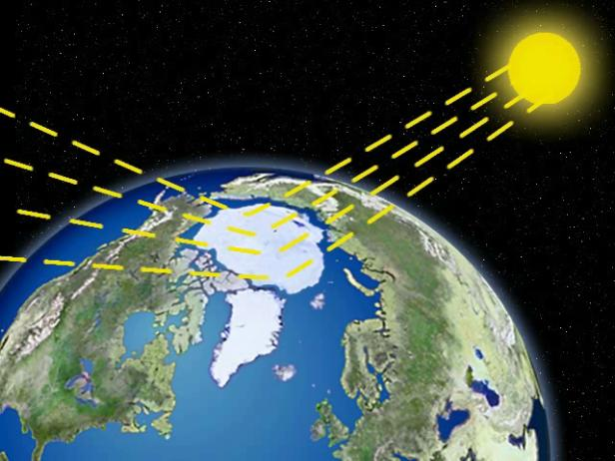
The Arctic and Greenland
Notes:
Now, let‘s have a look at the northern part of the planet. We have the Arctic Ice and just below it, the Greenland Ice. Does anyone have an idea what the two main differences between these ice areas could be? (Question directly to the audience)
The first main difference is that while the Arctic Ice is swimming in water, there is land under the Greenland Ice.
The other main difference is the thickness of the ice. 1. Does anyone have an idea how thick the Arctic Ice is? (question directly to the audience)
It’s on average 2 to 3 meters thick.
2. And does anybody know how thick the Greenland Ice Sheet is? (questions directly to the audience)
It about two to three thousand meters thick – 2 to 3 kilometers!
So, because the Arctic Ice is not very thick and it’s already in water, if it melts, the sea level won’t rise. But if the Greenland Ice melts, which is so incredibly thick and on land, then the sea level will rise by seven meters all around the world. And this is exactly what will happen if the temperature rises by more than 2 degrees Celsius. So we have to make sure that the climate crisis stops at 2 degrees.
Even if the melting of the Arctic ice will not let the sea level rise, it is still very important for us. Because of the light color of the ice, it is like a mirror that reflects the sun's rays. You can easily imagine this when you think of a white and a black t-shirt in summer. The black T-shirt is much warmer because the color stores the heat, but the white T-shirt reflects the sun's rays back. This is called the albedo effect.
The melting of the arctic ice is also a tipping point. Because when the ice is gone, water appears, which is much darker than ice and therefore absorbs much more heat from the sunrays. This causes the sea to heat up more and more and leads to even more ice melting.

Slide 13
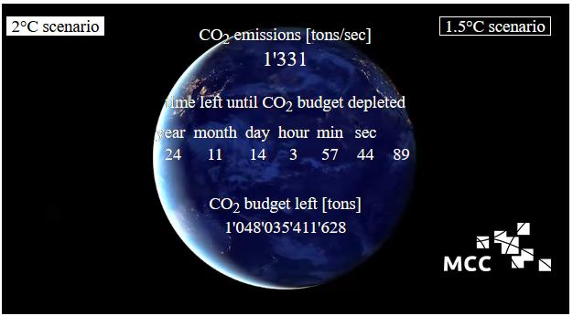
Our CO₂-Budget for 2°C: 25 Years
Status November 2020
© MCC
Notes:
How urgent the problem is becomes clear when you look at this clock.
This is the CO₂ clock from the Mercator Research Institute: it shows how little time we have. If we don't reduce today's CO₂ emissions, we only have a good twenty-five years until we reach the plus 2°C limit. Then our CO₂ budget, so the amount we can still emit before we reach the plus 2°C limit, will be exhausted. The budget is the large number you see at the bottom, that is just over a gigatonne, that is a thousand billion tons.
By the way, if we only want to warm up the earth by a maximum of 1.5°C, we only have 7 years left. That is very, very little time.
The good thing about it: what you cause yourself, you can also undo yourself. The bad thing about it: far too little is still being done.

Slide 14
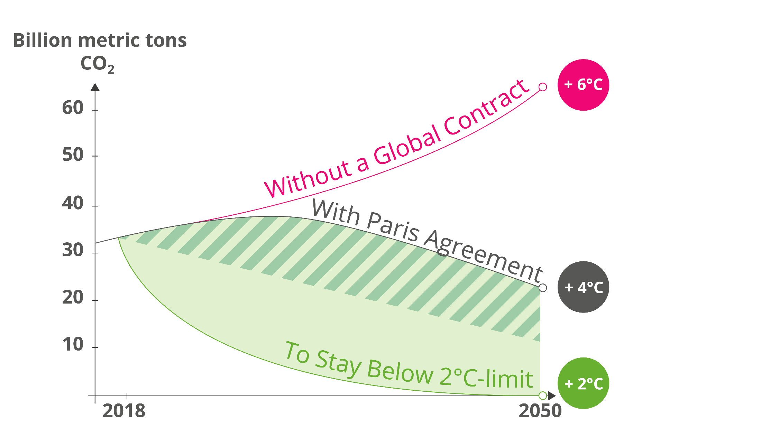
At 2°C temperature rise the climate topples.
Notes:
Some of our politicians have already realized that we finally have to do something about the climate crisis. Every year, all the countries of the world meet at a climate conference and discuss what can be done about the climate crisis.
Unfortunately, this is very complicated and the countries of the world do not all pull together, so things move very slowly.
But at the UN Climate Conference in Paris in 2015, the negotiations were a great success: for the first time, a global treaty was signed in which all countries agreed to do something about the climate crisis.
Here you can see a graph showing the importance of the global treaty.
The red line shows what will happen if we continue as before and do not reduce our CO2 emissions: the temperature increase will go through the roof. This would mean that we would exceed many tipping points.
If all countries stick to the world contract, the world temperature would increase by 4°C, which is the grey line. Unfortunately, this is still far too much and the politicians actually know that, but it was the first time they could agree on anything at all.
To prevent bad irreversible consequences, however, the 4°C of the world treaty is not enough. We absolutely have to keep the plus 2° C limit. But we still have to do a lot to achieve this.

Slide 15
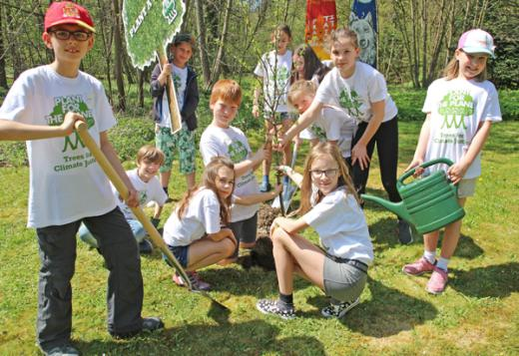
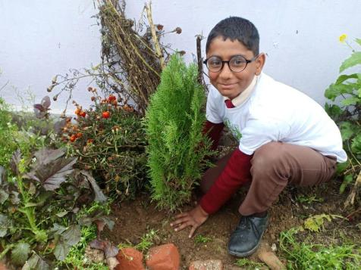
What can we do?
Notes:
There are various solutions to the climate crisis. It is best to do all three at the same time:
1. Avoid CO₂– emit as littleCO₂ as possible. This is unfortunately not quite possible, so lets have a look to solution two
2. Reduce CO₂ - we must encourage everyone to emit less CO₂, especially large companies.
3. Bind CO₂– CO₂, which cannot be avoided, must be extracted from the atmosphere and bound. The simplest means for this is the "miracle plant: tree". This is what we do at Plant-for-the-Planet: we plant trees together so that more CO₂ can be absorbed from the atmosphere and the global temperature rises less rapidly.

Slide 16
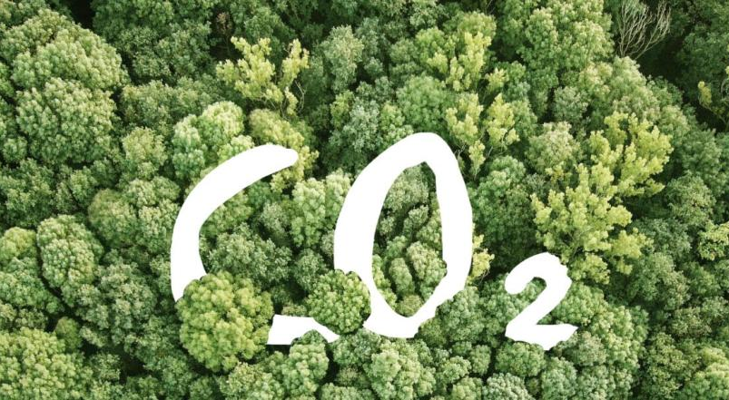
CO₂-Joker: Trees
Notes:
Why does Plant-for-the-Planet like trees so much and what do they have to do with the climate crisis?
We have 2 problems:
Rising temperatures and the world is unjust.
Trees can help us with both problems.
To make the world more just, we can plant trees in the Global South. In other words, exactly where there is little prosperity. We can create jobs and prosperity by planting trees.
But trees also help us when it comes to limiting the rise in temperature.

Slide 17
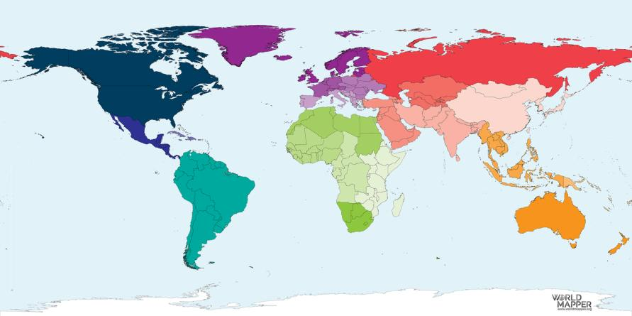
The world by landmass…
© Worldmapper.com
Notes:
Lets have a look at what I mean by injustice.
Here you see the world as you know it from the atlas.
The bigger a country is by area, the bigger it is on this map here.
But if you look at the world a little bit differently....

Slide 18
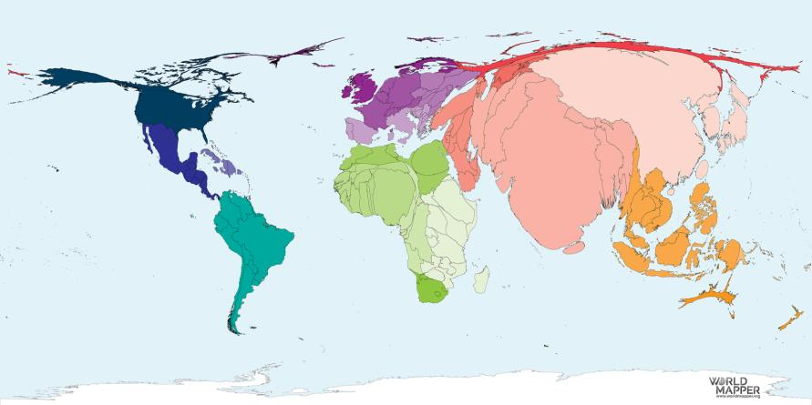
… by global population
© Worldmapper.com
Notes:
...then it no longer looks at all like the world we know.
For example this map shows the world by population, so where how many people live.
North America and Europe are not that big here, together they make up only a small part of the world population, a little over 10%.

Slide 19
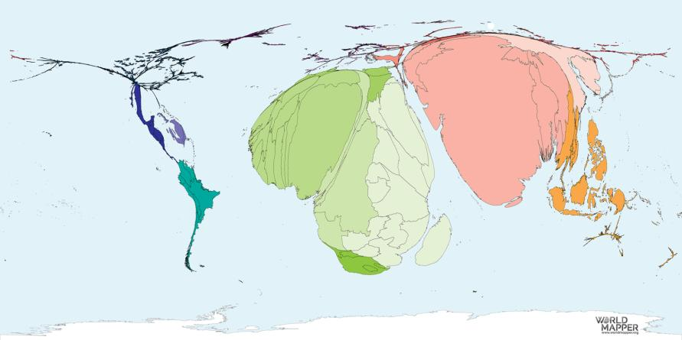
… by people with less than $2 a day
© Worldmapper.com
Notes:
On this map you can hardly see North America and Europe at all.
The map shows us where many people live on less than two dollars a day.
Africa and India are very big, which means that more poor people live there.

Slide 20
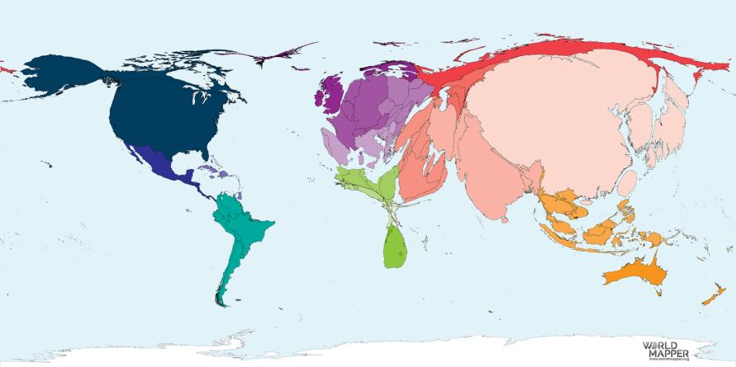
… by CO₂ emissions
© Worldmapper.com
Notes:
If we now look at the world in terms of CO₂ emissions, we see that Africa is almost impossible to see.
Many people live there, but they only produce little CO₂ .
China is very large on the map - many people live there. In addition, a lot is produced there for the whole world.
Europe and North America are also very large. This means that a lot of CO₂ is emitted here.
But we are only a small part of the world's population that causes a huge amount of CO₂. So we ourselves are a big part of the problem.

Slide 21
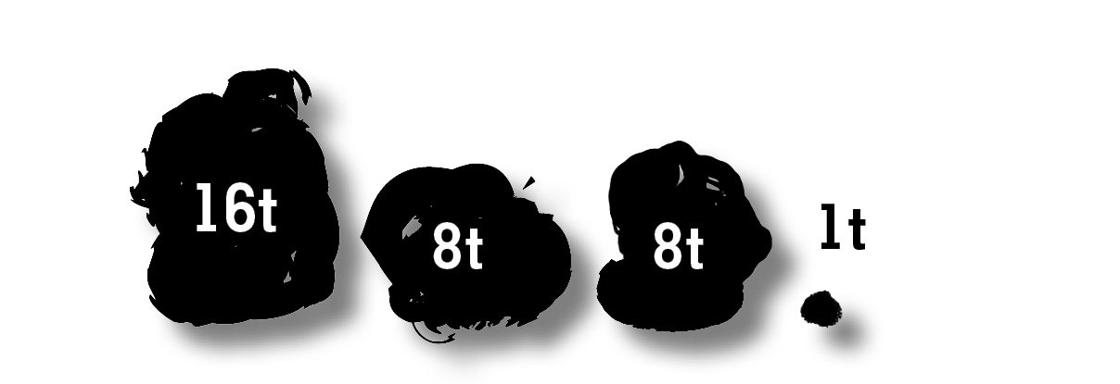
CO₂ Emissions per person per year
in North America in Europe in China in Africa
© Plant-for-the-Planet
Notes:
Here the CO₂ emission is shown a little bit different. We already saw on the map earlier that this is not evenly distributed worldwide.
In North America, for example, a person emits an average of 16 tons per year.
In Europe and China, about 8 tons per person are produced. Still far too much.
In Africa, people are responsible for an average of about 1 ton per year. Many environmental catastrophes caused by the rise in temperature, however, happen right here.
This is how unfair the climate crisis is.

Slide 22
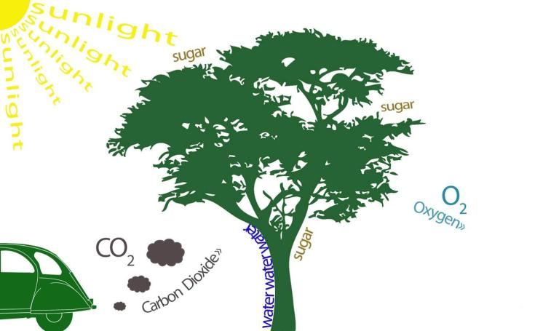
Photosynthesis
Notes:
Let’s get back to trees. I would like to explain to you why trees are a true miracle of a plant.
Trees act as carbon sponges to filter CO₂ from the air. This works through photosynthesis. Trees are exactly the opposite of us humans: they breathe in CO₂, store the C in their wood and release oxygen, known as O₂. By storing the C for a long time, they take it out of the atmosphere like a sponge and the temperature rises less rapidly.
Trees are also called "the green lungs of the earth" because of their photosynthesis abilities.
The important thing is that the trees cannot solve the climate crisis on their own. But they buy us time because they reduce the amount of CO₂ in the atmosphere. We can use this time to reduce our CO₂ emissions. This is why trees are an important time saver in the fight against the climate crisis.

Slide 23
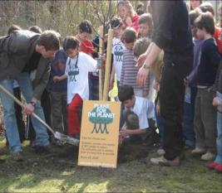
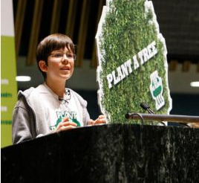
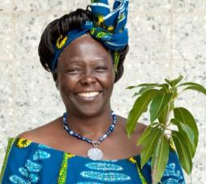
Our Story
Our Inspiration
First tree 2007
UN-speech 2011
Notes:
We were not the first to come up with the brilliant idea of planting trees.
Wangari Maathai, a Nobel Peace Prize Laureate from Kenya, was the first female professor there and also Deputy Minister of the Environment. She was a woman who recognized the incredible benefits of trees before we did. That is why she and other women have planted over 30 million trees in 30 years. When Felix had to prepare a school presentation on the climate crisis in 2007, he heard about it and thought: "I want that too!“ And so Wangari Maathai inspired Felix to found "Plant-for-the-Planet".
Only 4 years later Felix gave a speech to the United Nations. The United Nations, or UN for short, is a union between almost all countries of the world. The representatives of the member countries meet regularly to discuss current problems in the world and find solutions together. Felix asked them to plant 1,000 billion trees together in 2011.
Shortly afterwards, the United Nations World Tree Counter was handed over to the children of Plant-for-the-Planet. Connection to Wangari Maathai.

Slide 24
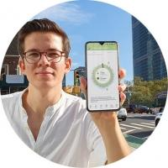
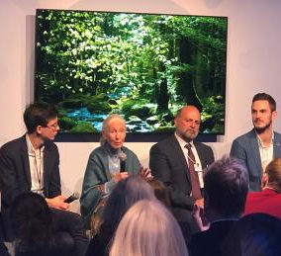
Our Story
Planting-Platform 2019
Tree study 2019
Notes:
Of course a lot has happened since then, but the past year was especially important for us.
In 2019 we officially launched the Plant-for-the-Planet App. We developed the UN tree counter further and turned it into an app. I will tell you more about this later.
In addition, a study was published in 2019, which brought great attention to tree planting worldwide. What is our connection to it? We provided the questions for this study. Because two things interested us:
Namely:
1. "How many trees actually grow on earth?
2. "How much space is there on Earth to plant more trees?"
We have searched for answers all over the world. And then we were very surprised, because: nobody could tell us!
Nobody has ever tried to find an answer to these questions. And then we found Tom, a scientist who wanted to help us.

Slide 25
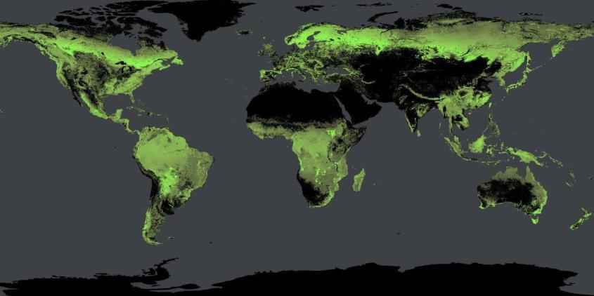
3 Trillion trees exist
© Crowther Lab
Notes:
He and his colleagues spent a long time researching and calculating how many trees are currently growing in the world.
He was then able to answer our first question: Today, about 3 trillion trees grow on earth.
Everywhere you see green on this map, trees are growing.
Our second question was even more difficult: "How much space is there on earth to plant even more trees?“

Slide 26
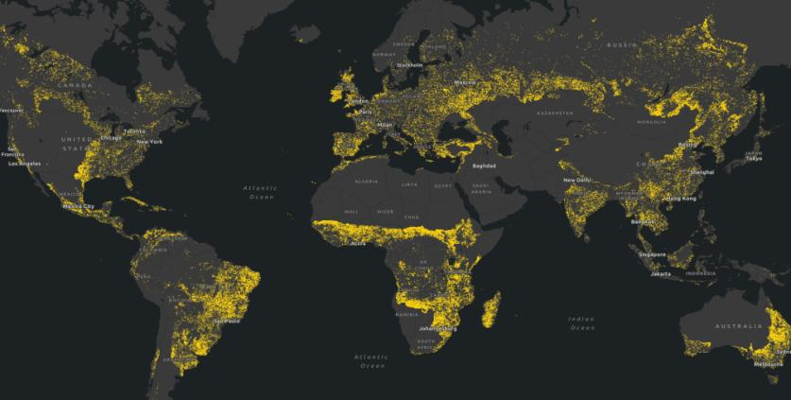
…space for 1 trillion more trees!
© Crowther Lab
Notes:
Your result: we have room for 1 trillion additional trees. This area corresponds to over one billion soccer fields (1.37 billion).
So we now have the scientific proof that we can still plant many many trees. That is why we want to mobilize people to plant 1 trillion additional trees worldwide. These trees store the CO₂ and thus give us important years as additional carbon stores to further reduce our CO₂ emissions.
The topic has also reached the business and political communities. At an important international meeting, the World Economic Forum in Davos, Switzerland, the heads of the largest companies and politicians launched an initiative. They joined us and the scientific community and called for 1 trillion trees to be planted by 2030.

Slide 27
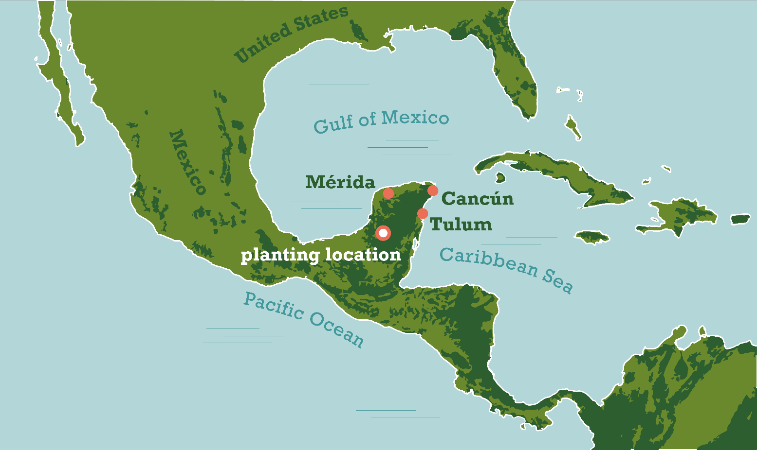
Planting area in Mexico
Notes:
We at Plant-for-the-Planet of course also plant trees in the Global South ourselves. More precisely, on our own planting area on the Yucatán Peninsula in Mexico. Where that is, you can see here (red-white dot).

Slide 28
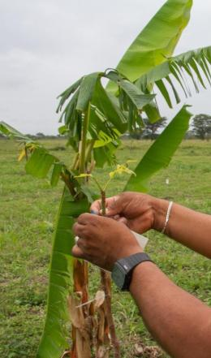
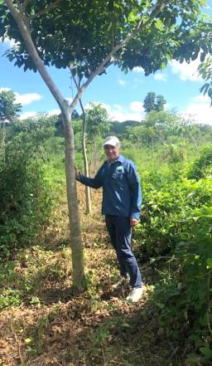
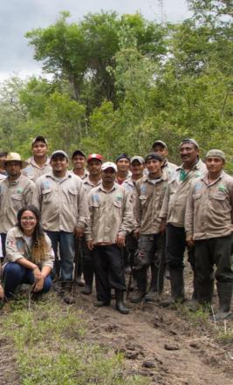
Planting area in Mexico
Notes:
Since 2015, We have already planted over 6.3 million trees there. We plant 8 different native tree species, for example the trumpet tree.
Because Mexico is in a different climate zone, the trees there grow much faster than they would in our country, and therefore absorb CO₂more quickly.
Plant-for-the-Planet employs more than 100 people there, who plant and care for the trees every day. So with our planting project we can create many jobs for the local population.

Slide 29
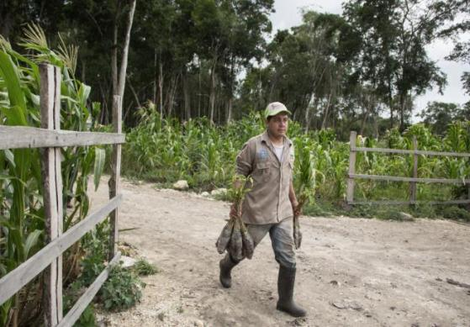
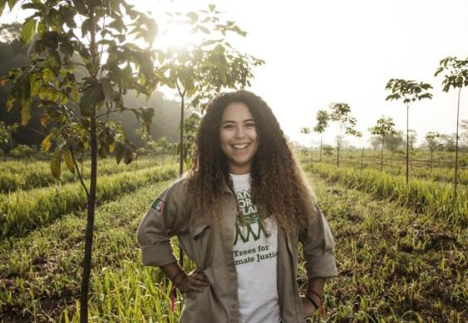
We need 10,000 projects worldwide
Notes:
But what good is it to us if we do our best and plant as many trees as possible when other people don't participate? Alone we can never manage to plant enough trees against global warming.
We will plant 100 million trees on our planting area by 2030. But our goal is 1 trillion trees. That's why we need another ten thousand projects like ours worldwide to plant enough trees.

Slide 30
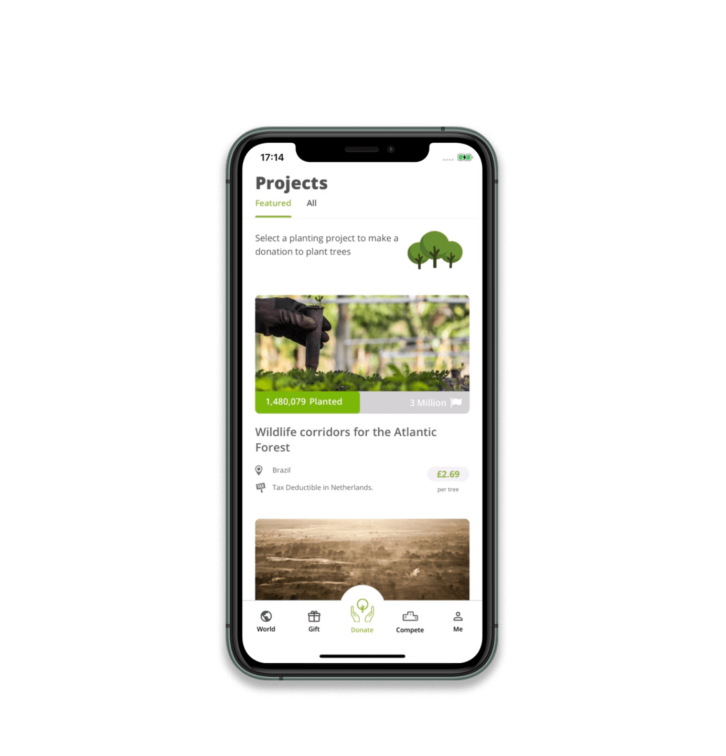
Plant-for-the-Planet App
Online:
trilliontreescampaign.org
App Store:
Plant-for-the-Planet
Notes:
And there are already many planting projects that pursue a similar goal as we do. So one of our Climate Justice Ambassadors thought: Why don't we make an app to bring together planting organizations around the world with people who want to donate trees? Sagar shared the idea with Plant-for-the-Planet and everyone thought it was great.
That's why we now have a Plant-for-the-Planet planting platform. On our homepage and with our app you can view the individual planting projects and donate trees with just one click. So it is very easy to plant trees worldwide. Excuses like "I don't have a garden" or "I don't know how to do that" don't count anymore.

Slide 31
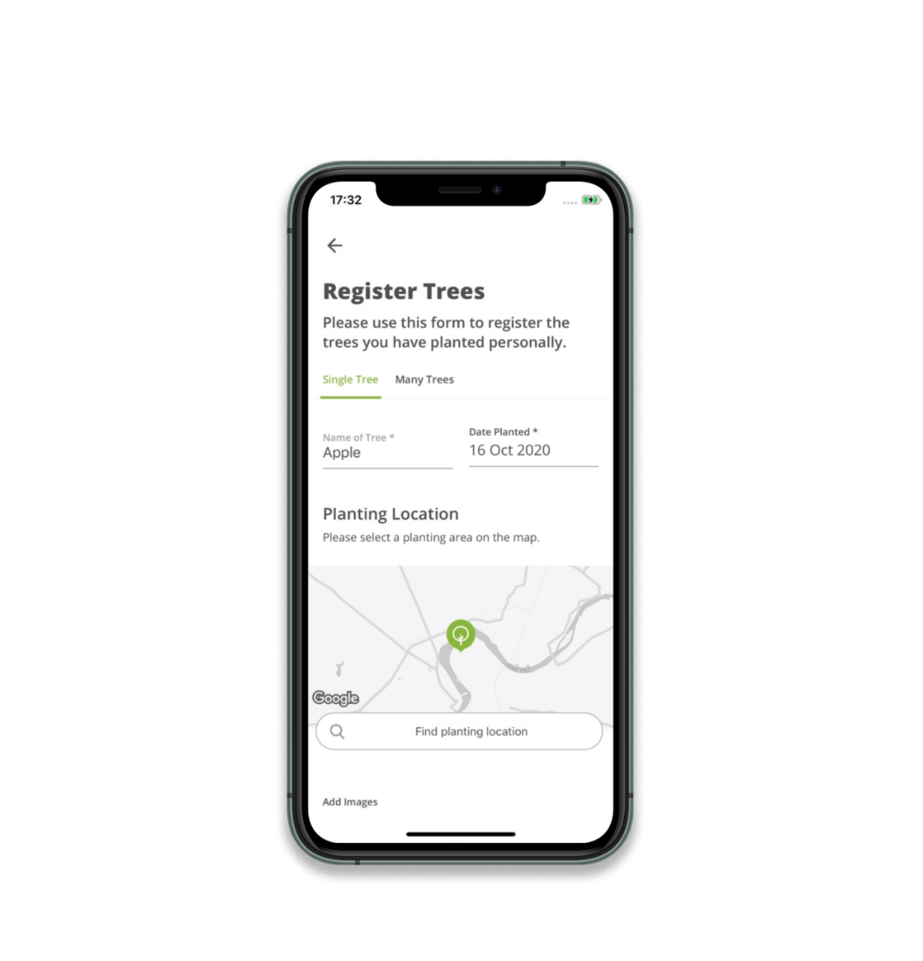
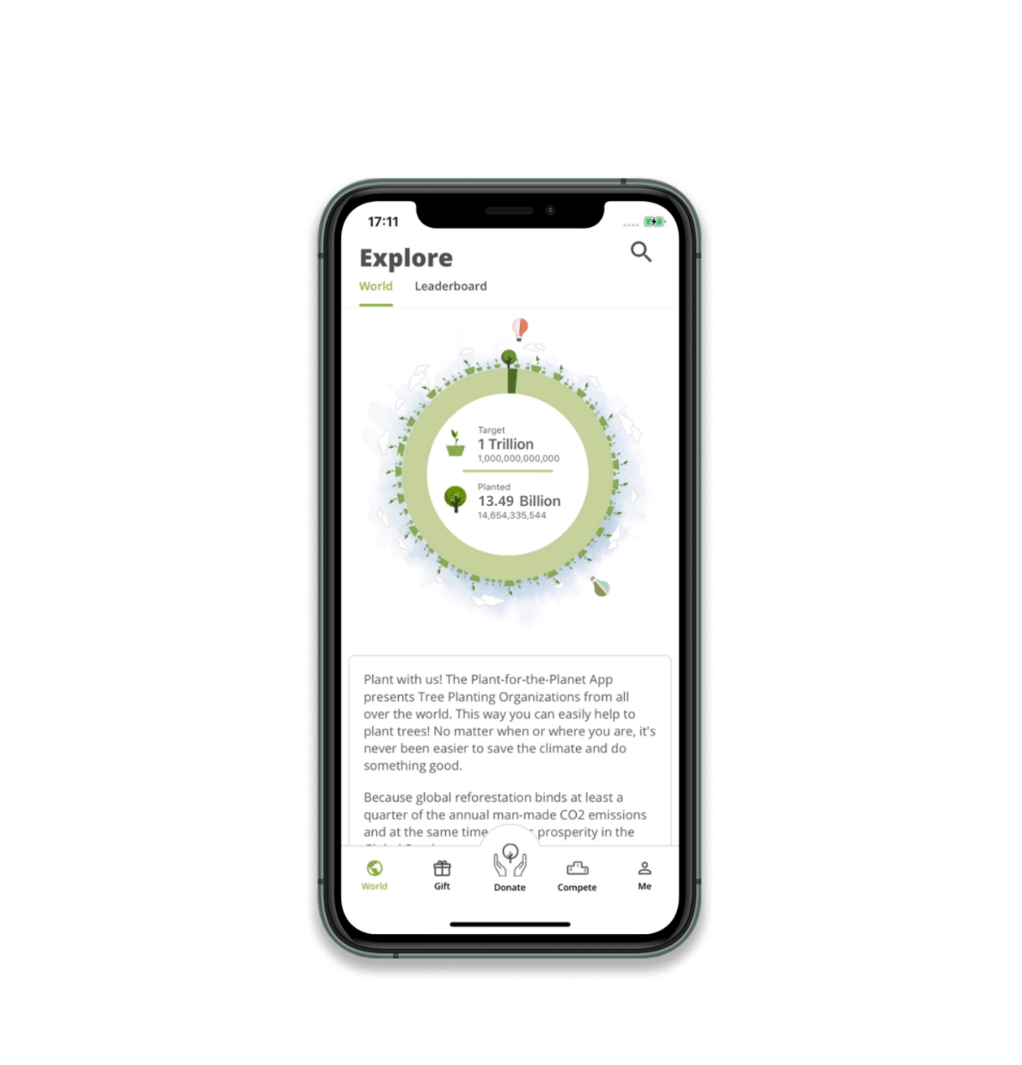
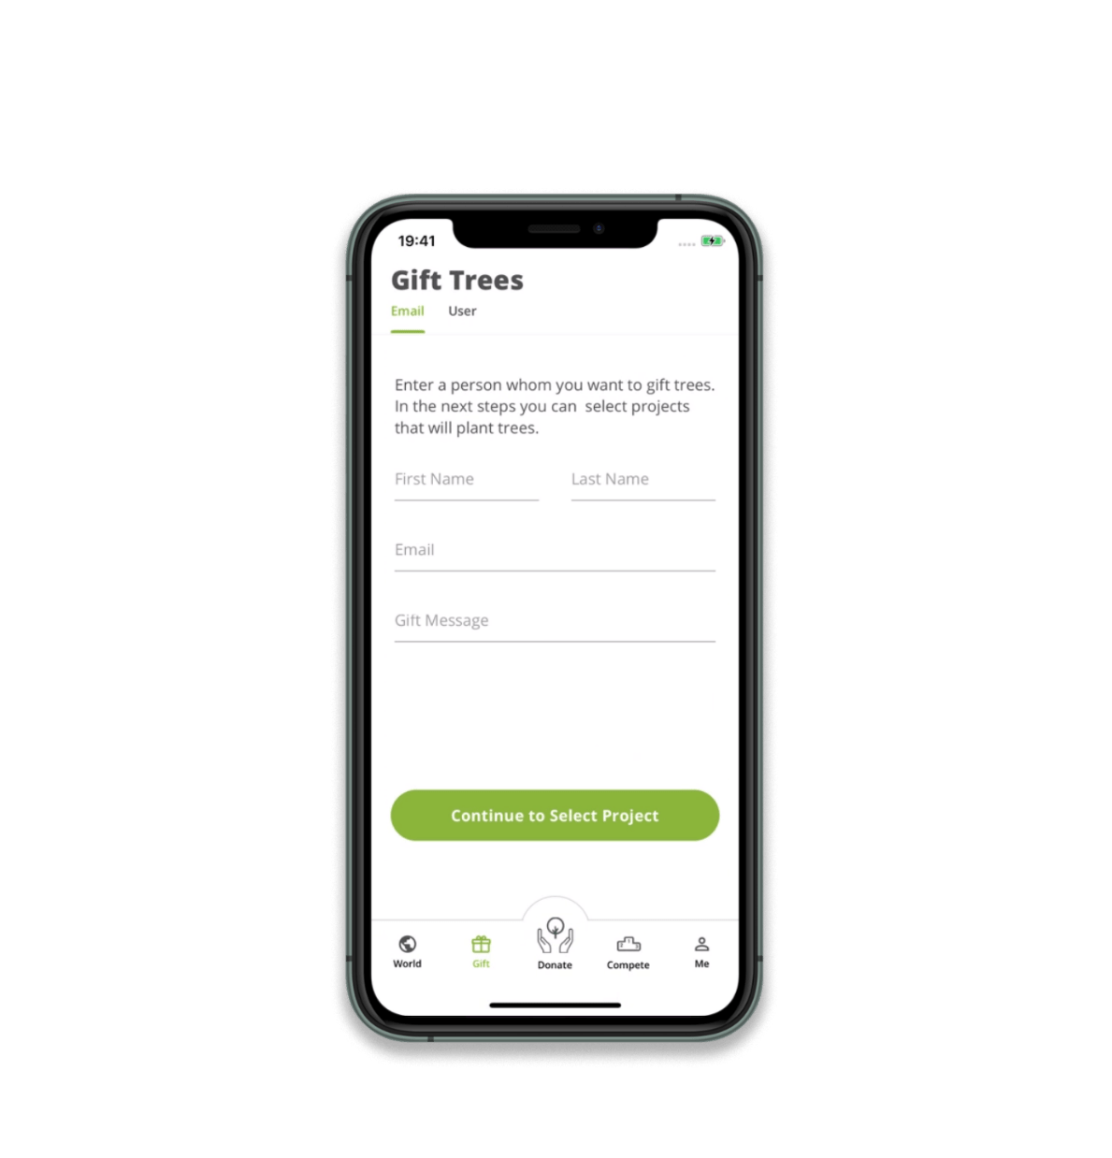
Register and gift trees
Notes:
But the app can do even more!
For example you can create your own tree counter, just like Paulina. She has set herself the goal to plant 1,500 trees and has already planted 204 trees!
By the way, you can not only donate trees, but also plant some at home and then register them in the app. This also grows your tree counter.
And what I think is really cool is that you can give away trees! You can give trees to your friends and relatives for their birthday or you just ask for trees on your birthday. Now that is a meaningful gift!

Slide 32

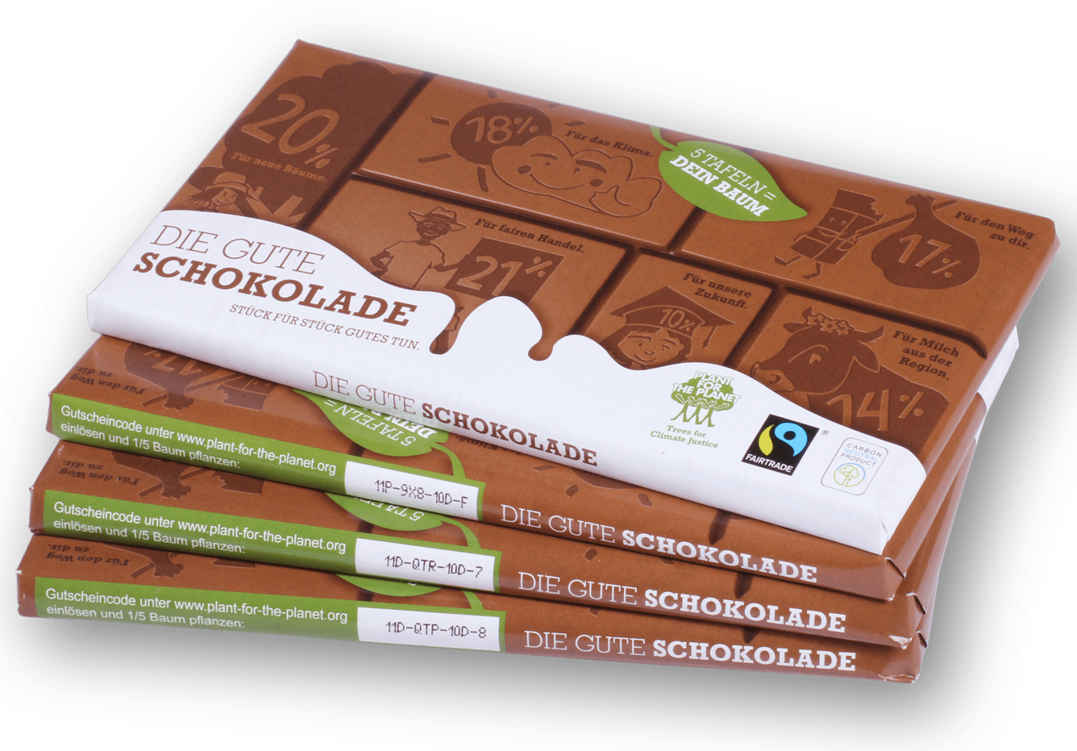
Die Gute Schokolade
Notes:
We have designed our own product to make tree planting especially delicious: The Change Chocolate.
The special thing about our chocolate is that we plant a tree for every five bars sold. Over 6 million trees have already been donated by the chocolate. And each chocolate carries a code that you can redeem on our homepage or our app. So you can plant delicious trees.
By the way, this chocolate is of course fairly traded and climate neutral.
And you can give it as a present - after all, everyone likes chocolate.
Sadly, we only have the chocolate in Germany and Austria at the moment.

Slide 33
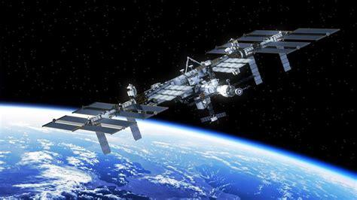

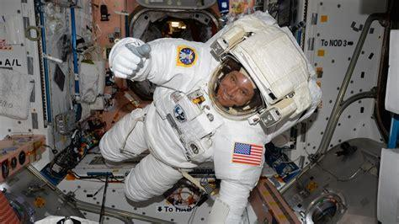
A little bite for the crew,
a big step for our message.
Notes:
A few years ago, we gave our Chocolate away as gifts and sent it on a long journey. Because we asked the astronauts on the International Space Station if they would like to try the Good Chocolate.
Shortly afterwards, 12 bars of the Change Chocolate flew to the International Space Station on board a rocket.
A LITTLE BIT FOR THE CREW, A BIT STEP FOR OUR MESSAGE.

Slide 34
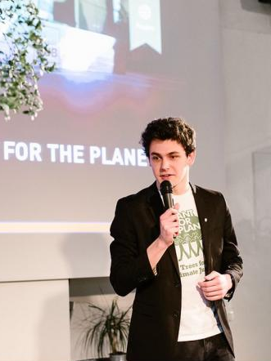
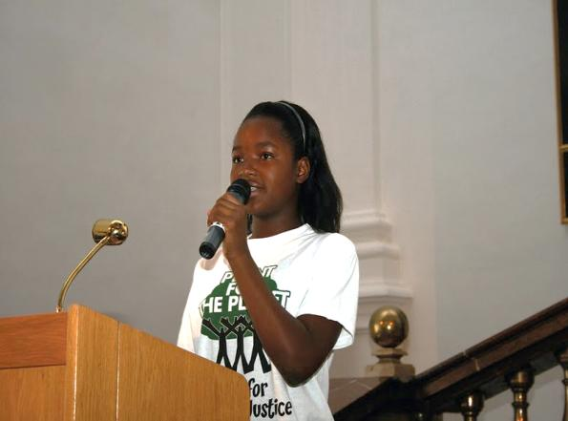
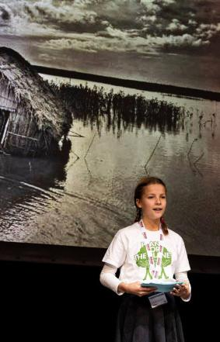
Speak up! 91.666 Climate Justice Ambassadors in 75 countries
Notes:
We children and young people from Plant-for-the-Planet not only plant trees, but also have another goal: we inform other children and train them as Climate Justice Ambassadors. The climate crisis is about OUR future. Adults may have thirty or forty years to live, but we children have eighty years left in the world and have to live with the climate that adults leave us.
We are trained in academies to become Climate Justice Ambassadors, in order to fight for our future. Since 2007, we have been getting involved by giving lectures and discussing with politicians.
There are already over 91,000 Climate Justice Ambassadors in 75 countries around the world!

Slide 35

1. An Ambassador presentation
Notes:
An academy begins with a presentation by an ambassador, who was trained previously. A lecture on the climate crisis and also on the worldwide justice crisis.

Slide 36

2. World game
Notes:
Through the World Game we learn how population, wealth and CO₂ emissions are distributed around the world and how they are interrelated.

Slide 37

3. Rhetoric training
Notes:
Afterwards we all practice giving lectures ourselves. So that we can spread the message, in our classes, in other classes and our school and also in front of adults.

Slide 38

4. We plant trees
Notes:
And then of course we also plant trees at all these academies.

Slide 39

5. World Café – we collect ideas
Notes:
And we collect ideas on various questions, for example: How do we get other children and young people to join in? Or how do we get the media, i.e. newspaper, television, radio, to report about us? How do we organize a planting campaign?
Then we collect ideas about what we want to do ourselves in our schools. How many trees we want to plant or where we want to hold lectures.

Slide 40

6. We present our ideas
Notes:
At the end of the academy we then present these plans to the other children and young people.

Slide 41

7. We become Climate Justice Ambassadors
1. Ein Botschafter für Klimagerechtigkeit hält einen Vortrag
1. Ein Botschafter für Klimagerechtigkeit hält einen Vortrag
Notes:
And everyone receives a certificate as an Climate Justice Ambassadors .

Slide 42

© Neue Westfälische Zeitung
Notes:
When we are trained Climate Justice Ambassadors, our most important task is to give lectures on the climate crisis and explain why trees are an important time joker for us. Like I do, for example at city festivals or in my school. The presentation slides and text can be found on the Plant-for-the-Planet website and information material can be ordered free of charge from the Plant-for-the-Planet office. So everyone who cares about the topic can participate, including you.
Other children and teenagers have also had great performances: Here you can see 12-year-old Jana, for example. Like us, she is an ambassador for climate justice and spoke at a major conference directly after the head of Deutsche Bank and the Prime Minister of North Rhine-Westphalia in Germany.
The newspapers didn't talk about the powerful people. Instead, they said that Jana outshone all the others. These examples show us again and again that we are listened to!

Slide 43

Run4Trees
Notes:
And if you really want to organize something, I have a suggestion: just organize a fundraising run at your school together with your classmates.
All you need are motivated runners, a fixed running route and parents and friends who will donate trees for each round you run. You can find more information on the homepage.

Slide 44



Campaign:
Stop talking. Start planting. 2.0
Notes:
In order to make everyone aware of the importance of planting trees, we have started the "Stop talking. Start planting." Campaign. We want politicians and adults to stop talking about the climate crisis and start acting. We have therefore put a hand in front of the famous people.
Now we have further developed our campaign so that everyone can join in. And it's very simple: Put a leaf in front of your mouth and take a picture. This way you can show others that it is time to do something! Invite your friends, families, politicians and celebrities from your region to take a picture so that as many people as possible can participate and understand why planting trees is so important!

Slide 45

Planting trees worldwide
Notes:
Finally I would like to ask you a question again. Have you ever asked yourself who actually emits a lot of CO₂? Do you think it's us children and adults, so individuals? [Waiting for answers from the audience]
That's right, it's mainly companies that emit a lot of CO₂. That's why we also believe that companies must take responsibility for their CO₂ emissions. They should look at where they can reduce their emissions, and wherever CO₂ cannot be avoided, we want them to plant trees for it. Because the trees will then store the CO₂ they emit.
Every adult works in some kind of company. Why don't you talk to your parents or relatives and ask them if you can give a lecture on the climate crisis in their company. If they agree, you can convince them to plant trees.
For every person you meet, you can ask: "Do you already have a forest? - If not, set a tree target in your own tree counter" - it's great if each person plants 1,000 trees by the year 2030.
If only every 10th person participates, then that's enough to reach our goal of a trillion trees!

Slide 46


Plant-for-the-Planet today
Since 2007:
91.666 Climate Justice Ambassadors
More than 13.9 billion trees register on the World Tree Counter
An App with more than 140 planting organisations
Our goal by 2030:
1.000.000.000.000 trees
Status of
01/2021
Notes:
To end my presentation, I would like to give you a short summary of what Plant-for-the-Planet does:
Since 2007, we have trained over 91,000 Climate Justice Ambassadors in academies around the world.
We have asked people around the world to plant trees and have been allowed to register more than 13.9 billion planted trees in the official World Tree Counter.
And we launched an App with over 140 planting organizations that allows anyone around the world to donate trees with just one click, so that no one has an excuse not to plant trees anymore.

Slide 47
Notes:
But we still have a long way to go. Only together with you can we reach our goal of 1 trillion trees.
So join in, get involved and get active.
The climate crisis is about OUR future!
Thank you very much.

